Slide 1
.Melanoma. .Classification.
Ramiz Akhtar, Rayaan Faruqi, and Kunaal Sarnaik
October 11th, 2020

Slide 2
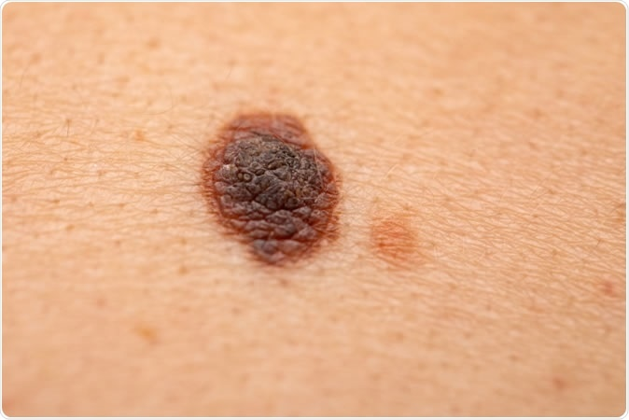
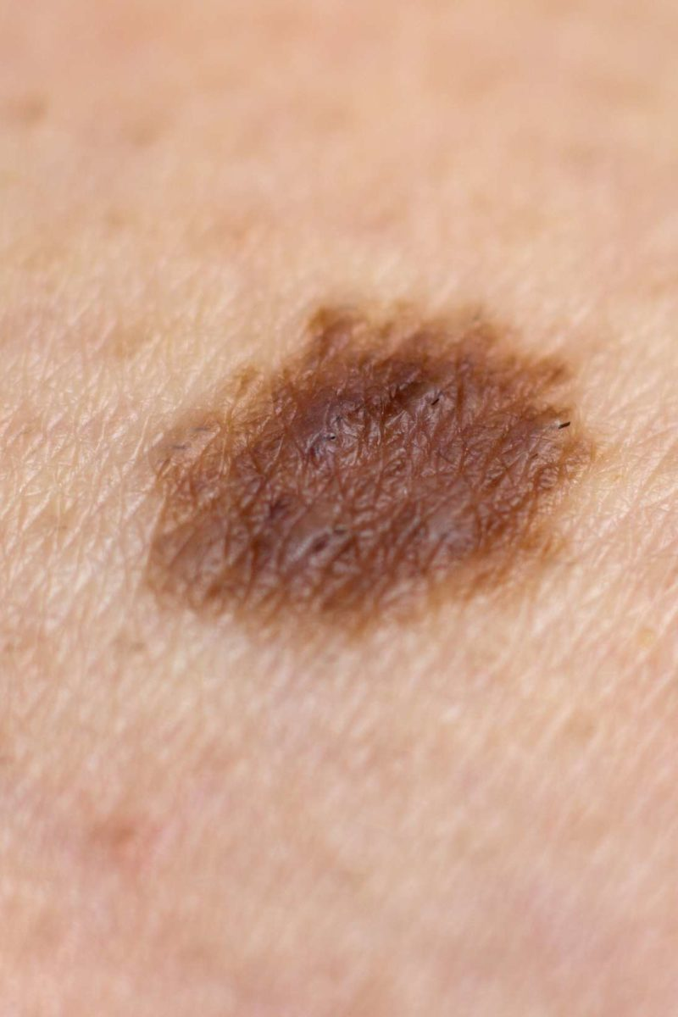
.Motivation.
What is the difference between the two images on the right?
Top - Melanoma
Bottom - Typical skin mole
Extremely difficult to differentiate which one is which
An estimated 76,380 Americans will be diagnosed with an invasive melanoma¹
While melanoma is less common than other skin cancers, it is more likely to metastasize relative to other types of skin cancers.²
What if there was a way to classify this early on?
In the safety and comfort of one’s own home (i.e., without having to obtain an expensive clinical diagnosis in person)
Providing such diagnostic information via a smartphone applications makes early detection both more feasible, accessible, and economical!
Higher likelihood of successful treatment outcome(s)
Ease of Use, Operability, and Accessibility
Raises awareness of a serious disease that affects the lives of many

Slide 3
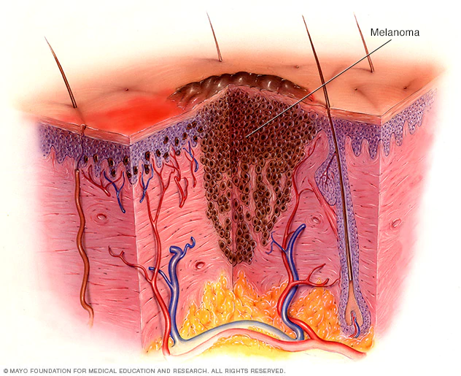
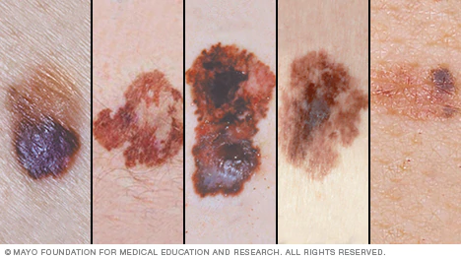
.Background.
What is Melanoma?
Per the Mayo Clinic, melanoma is the most serious type of skin cancer³
Develops in the melanocytes → The cells that gives one’s skin its pigmentation
Why is hard to diagnose?
Can develop anywhere on the body
Most melanoma cells still make melanin → usually brown or black
However, some melanomas do not make melanin → can appear pink, tan, or white
What are the clinical, financial, and psychosocial implications of a late diagnosis?
Clinical → Harder to manage melanoma progression in later stages
Financial → Higher cost of emergent operations
Psychosocial → Withdrawal from activities, avolition, and dysphoria

Slide 4
.Related Work.
Esteva et al. demonstrated dermatologist level classification of skin cancer with machine learning techniques, specifically a deep convolutional neural network (CNN)⁴
In addition to disease classification via images, as mentioned above, Chan et al. lists⁵
Disease classification using dermatopathology images
Assessment of skin disease using mobile applications and personal monitoring devices
Facilitation of larger scale dermatological and epidemiological research
Precision medicine
Substantial research has been funded to classify breast cancer tumors based on size and malignancy
Ray et. al. utilized a supervised machine learning approach to classify BC tumors based on both image and numeric datasets⁶
Dhahri et. al. optimized automated BC tumor classifiers using kNN, Random Forest, AdaBoost, etc.⁷
Relevant melanoma classification models based on numeric data and genomic data conducted
Current need: IMAGE DATA!!!! ⁸

Slide 5
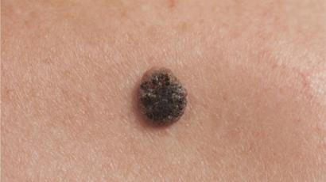
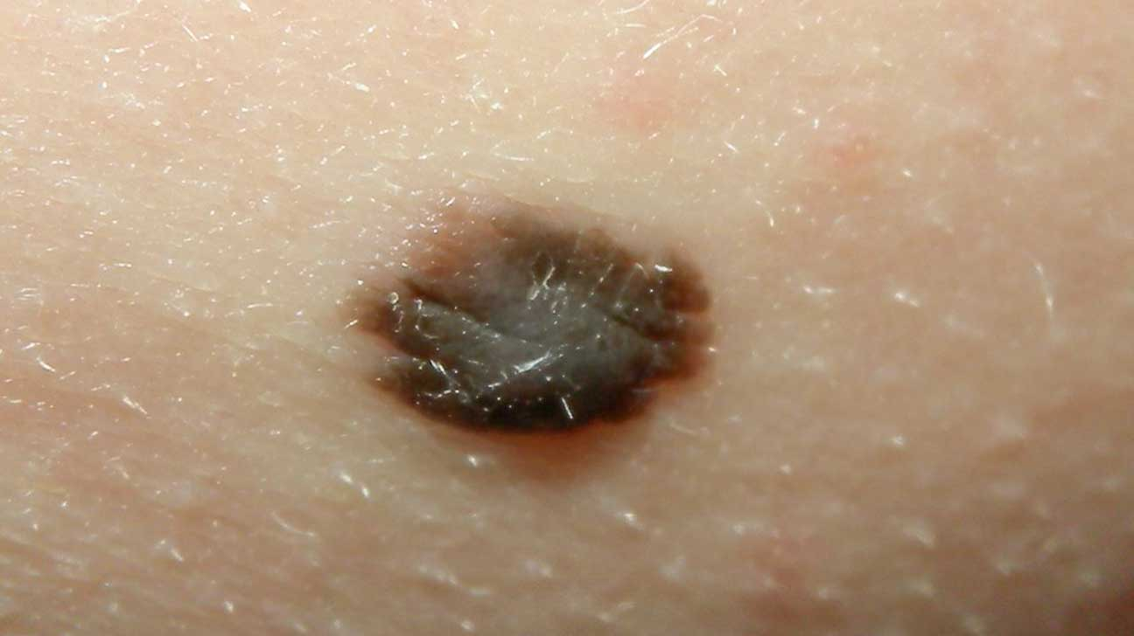
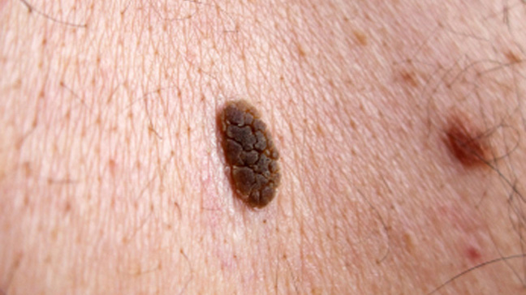
Claim/Target Task.
Using supervised multi-class classification to train and validate a model that can robustly distinguish the properties of a skin image as either:
Melanoma (top)
Non-melanoma skin (nevus) (middle)
Seborrheic Keratosis (bottom)
Dataset being utilized (2750 images of the three outcomes) : https://www.kaggle.com/wanderdust/skin-lesion-analysis-toward-melanoma-detection

Slide 6
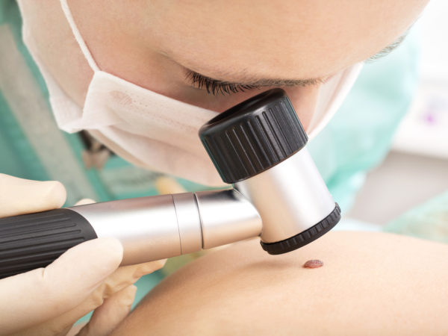


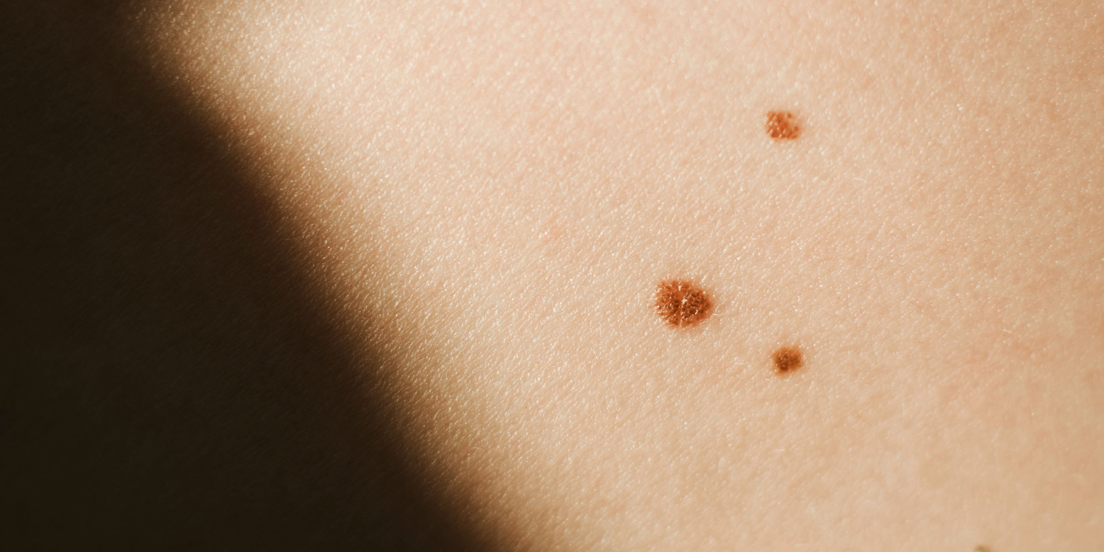


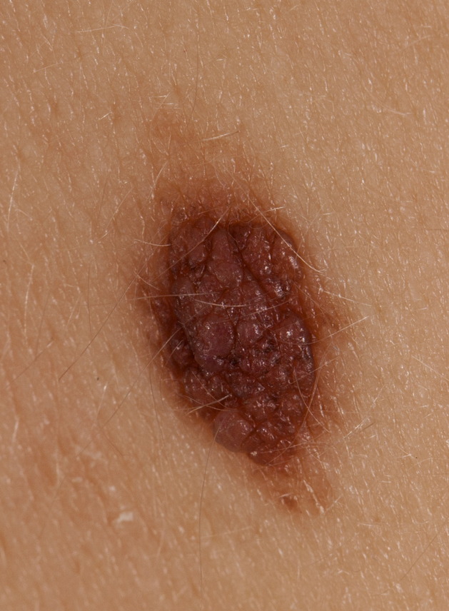

.Intuitive Figure.
Option 1.
Option 2
Early-Stage Melanoma Detected‼️

Slide 7
References
Glazer AM, Winkelmann RR, Farberg AS, Rigel DS. Analysis of Trends in US Melanoma Incidence and Mortality. JAMA Dermatol. 2017;153(2):225. doi:10.1001/jamadermatol.2016.4512
American Cancer Society. What Is Melanoma Skin Cancer? | What Is Melanoma? Published August 14, 2019. Accessed October 11, 2020. https://www.cancer.org/cancer/melanoma-skin-cancer/about/what-is-melanoma.html
Melanoma - Symptoms and causes. Mayo Clinic. Accessed October 11, 2020. https://www.mayoclinic.org/diseases-conditions/melanoma/symptoms-causes/syc-20374884
Esteva A, Kuprel B, Novoa RA, et al. Dermatologist-level classification of skin cancer with deep neural networks. Nature. 2017;542(7639):115-118. doi:10.1038/nature21056
Chan S, Reddy V, Myers B, Thibodeaux Q, Brownstone N, Liao W. Machine Learning in Dermatology: Current Applications, Opportunities, and Limitations. Dermatol Ther. 2020;10(3):365-386. doi:10.1007/s13555-020-00372-0

Slide 8
References
Ray R, Abdullah AA, Mallick DK, Ranjan Dash S. Classification of Benign and Malignant Breast Cancer using Supervised Machine Learning Algorithms Based on Image and Numeric Datasets. J Phys Conf Ser. 2019;1372:012062. doi:10.1088/1742-6596/1372/1/012062
Dhahri H, Al Maghayreh E, Mahmood A, Elkilani W, Faisal Nagi M. Automated Breast Cancer Diagnosis Based on Machine Learning Algorithms. Journal of Healthcare Engineering. doi:https://doi.org/10.1155/2019/4253641
Genomic Classification of Cutaneous Melanoma. Cell. 2015;161(7):1681-1696. doi:10.1016/j.cell.2015.05.044

